Slide 1
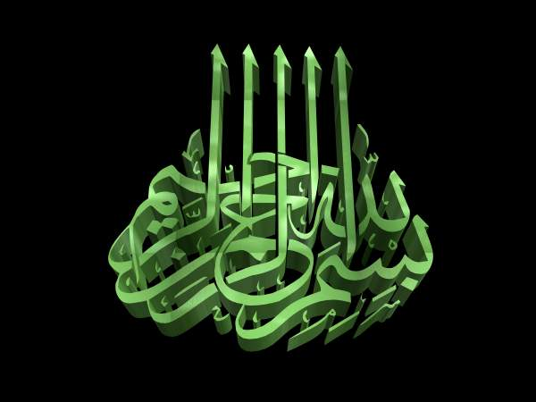
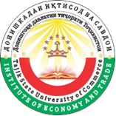
«Islamic financial products as a tool for market expansion banking services in the Republic of Tajikistan»
INSTITUTE OF ECONOMY AND TRADE OF TAJIK STATE UNIVERSITY OF COMMERCE
Developed by: senior teacher,
Bakhodurkhodzhaev Olim Raufovich

Slide 2
The overwhelming number of citizens of the Republic of Tajikistan professes Islam. According to the Statistical Agency under the President of the Republic of Tajikistan in the end of 2018 the population of our country exceeded 9166.1 thousand people and according to the preliminary data of the Agency 8927,7 thousand people, or 97.4% of the population are Muslims.

Slide 3
The Islamic principles which govern the operations of Islamic banks are also known as Shariah principles.
These principles come from the sources of the Holy Quran and Hadith:
One of the principles that must be adhered by Islamic banking is the prohibition of Riba. (interest)
Any interest or predetermined payment over and above the actual amount of principle which is Riba is strongly prohibited by the Quran

Slide 4

The second principle that must be adhered by Islamic banking is the prohibition of Gharar.
Gharar is generally translated as risk, hazard or uncertainty.

Slide 5
The third principle is prohibition of Maisir. In Islam, gambling known as maisir, and sometimes called qimar, is forbidden (Arabic: harām‎).

Slide 6
In Tajikistan in 2014 was adopted the Law of the Republic of Tajikistan "On Islamic Banking", which came into force from August 5th, 2014. This law was taken with the assistance of the Islamic Development Bank, which enables wide use of all opportunities of Islamic finance. The law provides that the National Bank of Tajikistan will provide Islamic credit institutions license to operate in the territory of the Republic of Tajikistan and regulate their activities.

Slide 7
In Tajikistan banking products based on Musharaka may find its application in agriculture. Islamic banks can finance the purchase of agricultural machinery and fertilizers, and private farms are investing in their labor and land. Gains and losses arising between the parties will be divided according to the contract.

Slide 8
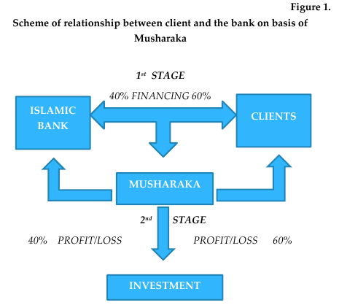

Slide 9
Murabaha - a kind of contract of sale to be applied in financing transactions. It is important to note that trading activity does not conflict with the principles of Sharia. Under this contract, the Islamic bank acquires a certain product and sells it to the customer at a premium with a payment delay (Figure 2). The entire risk of trading to go to the bank, i.e., Bank undertakes the acquisition, sale, storage, transportation, etc.

Slide 10
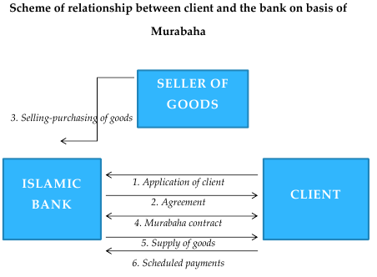

Slide 11
Proposals on development of activities of Islamic banks in RT
At the same time for the use of Islamic banking products in the Republic of Tajikistan we have to solve a number of problems:
Amendments to other legal instruments, in particular the Law "On the National Bank of Tajikistan", "On Banking activity", "On Currency Regulation and Currency Control", the Civil Code, the Tax Code and other legislative acts.

Slide 12
Advanced training in the field of Islamic Banking activities;
Raising awareness of customers about the benefits and the peculiarities of Islamic banking products. It can be achieved by developing banking marketing programs, organization of trainings and workshops for banking staff;

Slide 13
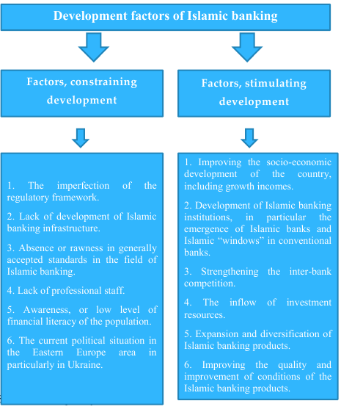

Slide 14
THANK YOU
MAY ALLAH THE ALMIGHTY SHOW US THE RIGHT PATH,
THE PATH OF HIS LOVED ONES (AAMEEN)

